Slide 1




NEXT GEN EMPLOYABILITY PROGRAM
Creating a future-ready workforce
Team Members
College Name
Student Name :G.R.Keerthika
Student ID :au814721104031
SRM TRP Engineering college

Slide 2

CAPSTONE PROJECT SHOWCASE
Project Title
Notes Sharing Web Application using Django Framework
Abstract | Problem Statement | Project Overview | Proposed Solution | Technology Used | Modelling & Results | Conclusion

Slide 3
Abstract
C
Collaborative Note Sharing PlatformThis web application addresses the need for a user-friendly and efficient platform for sharing learning resources. It caters to students, educators, and professionals by providing a central hub to create, store, and share notes. The platform fosters collaboration and knowledge exchange by enabling users to:Create and Organize Notes: Users can create notes in various formats like text, images, or attachments. An intuitive interface allows for easy organization with features like tagging and categorization.Share Securely: Granular permission controls ensure notes can be shared publicly, with specific users, or kept private.Search and Discovery: A robust search function facilitates easy discovery of relevant notes based on keywords, tags, or user-defined criteria.
Collaborative Editing (Optional): The application can optionally include features for real-time collaborative editing, enabling multiple users to work on notes simultaneously.This web application aims to streamline the note-sharing process, promote knowledge sharing, and enhance learning efficiency for individuals and communities.
Source :

Slide 4
Problem Statement
Students, professionals, and learners of all kinds struggle with scattered information and inefficient note-taking methods. Traditional note-taking involves physical notebooks or digital documents that can be difficult to organize, share, and collaborate on.
Source :

Slide 5
Project Overview
Note Sharing Web Application:
This project aims to develop a web application that facilitates users in creating, storing, and sharing notes online. The application will cater to a variety of purposes, including educational use by students and professional use for collaboration among colleagues.
Students: Can share class notes, study guides, and project materials.
Professionals: Can collaborate on documents, share meeting minutes, and brainstorm ideas.
Researchers: Can share research findings, lab reports, and data analysis.
General users: Anyone who wants to take notes, organize information, and share it with others.
This is a high-level overview. Further details can be fleshed out based on specific project goals and target audience.
Source :

Slide 6
Proposed Solution
.
Building upon the project overview, here's a proposed solution for the note sharing web application
Technology Stack:Frontend: React.js - A popular JavaScript library for building user interfaces. It offers a component-based structure, allowing for reusable UI elements and a smooth user experience.
Backend: Python (Django) - A high-level web framework known for its rapid development and clean syntax. Django provides built-in functionalities for user authentication, database management, and security features.
Database: PostgreSQL - An open-source, object-relational database management system (ORDBMS) known for its scalability, reliability, and robust security features.
This proposed solution provides a comprehensive framework for building a secure, user-friendly, and feature-rich note sharing web application. The specific features and functionalities can be further prioritized and customized based on project requirements and target user needs.
Source :

Slide 7
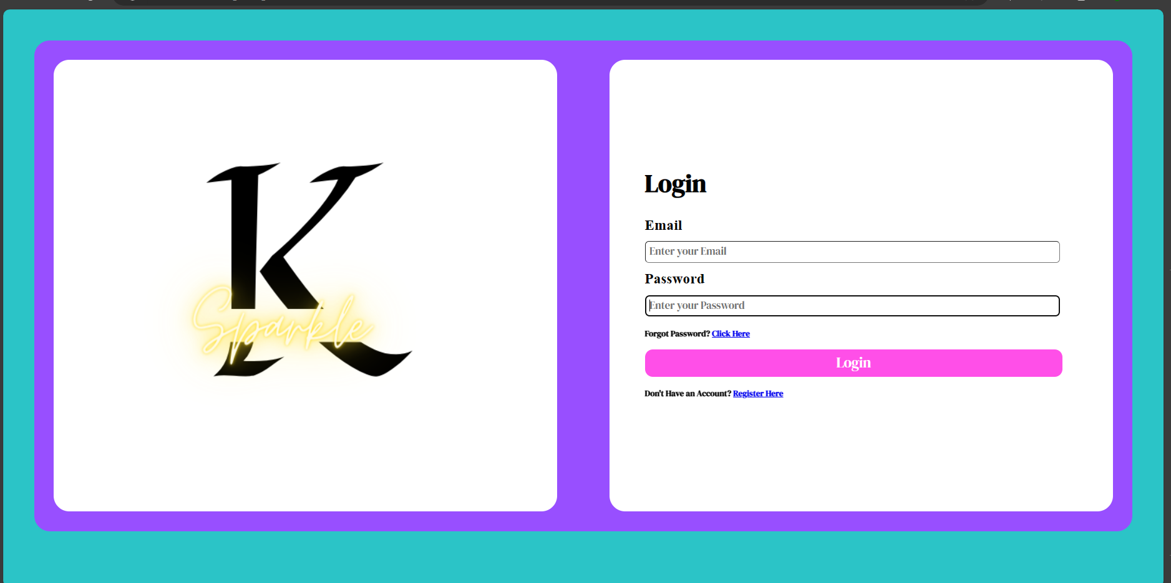
Login page
Source :

Slide 8
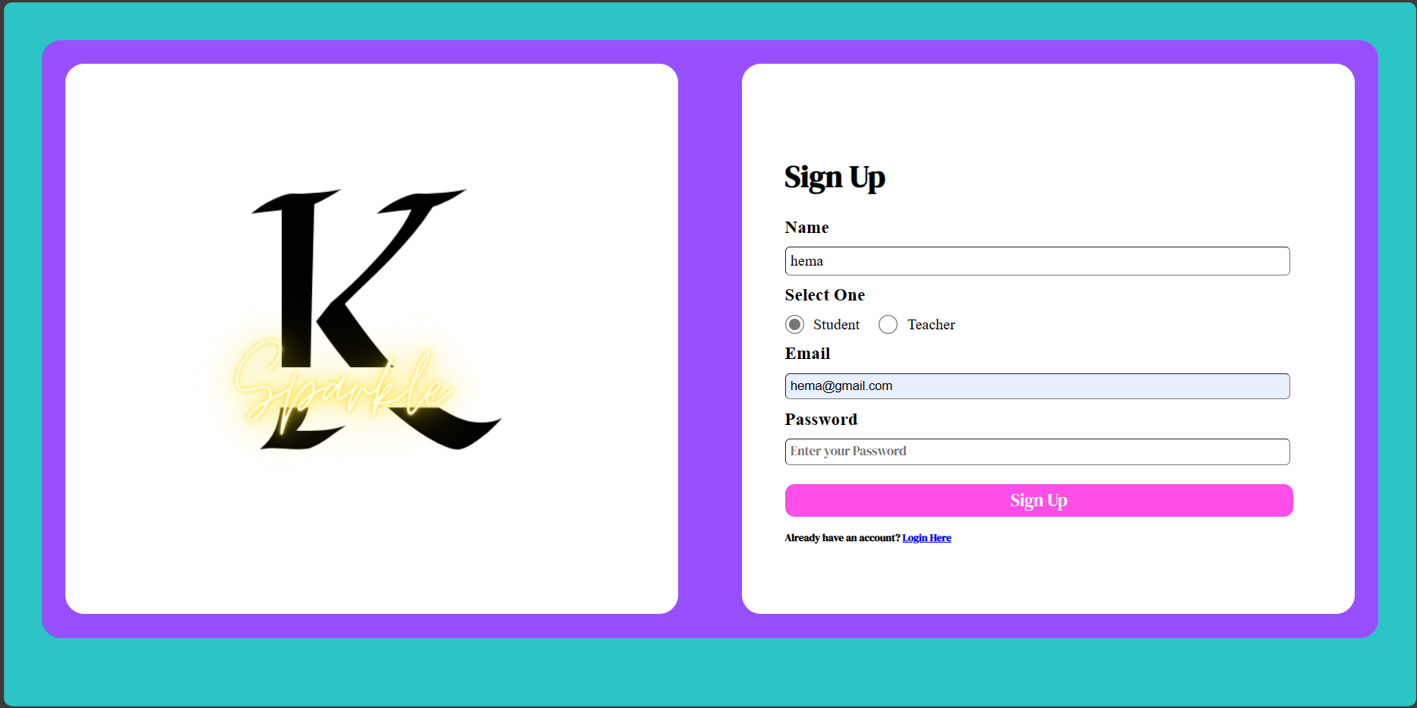
Sign in page
Source :

Slide 9


Technology Used
Front-end
Back-end
Source :

Slide 10
Modelling & Results
.
Database Schema: Design a database schema to store user accounts, notes, shared notes, user permissions, and any other relevant information. This schema should facilitate efficient retrieval and manipulation of data.
User Authentication and Authorization: Implement user authentication mechanisms such as username/password authentication or OAuth integration for logging in users. Additionally, enforce authorization rules to control access to notes based on user roles and permissions.
Note Creation and Management: Develop functionality for users to create, edit, delete, and organize their notes within the application. Consider providing options for formatting text, attaching files, and categorizing notes for better organization.
Sharing Mechanism: Implement a sharing mechanism that allows users to share their notes with other users or groups. This feature should enable users to specify the level of access (e.g., view-only, edit) granted to each collaborator.
Real-Time Collaboration: Incorporate real-time collaboration features using technologies like WebSockets or WebRTC to allow multiple users to simultaneously edit shared notes. Ensure proper conflict resolution mechanisms to handle concurrent edits gracefully.
Version Control: Implement version control functionality to track changes made to shared notes over time. This feature enables users to review previous versions of a note, revert to a specific version if needed, and view the history of edits.
Source :

Slide 11
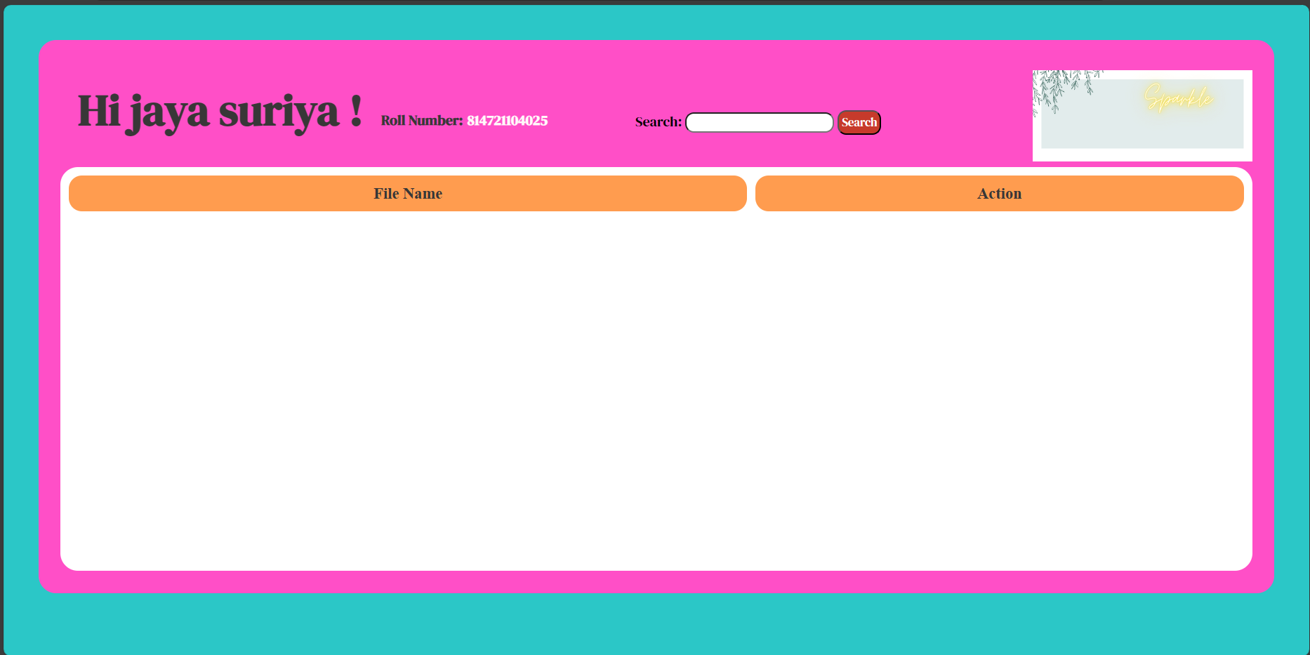
Student login

Slide 12
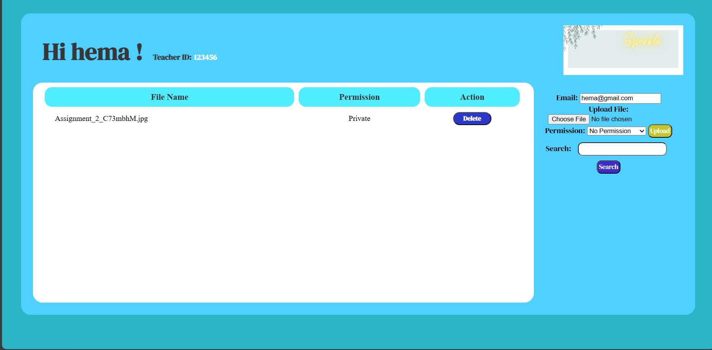
Teachers Login:

Slide 13
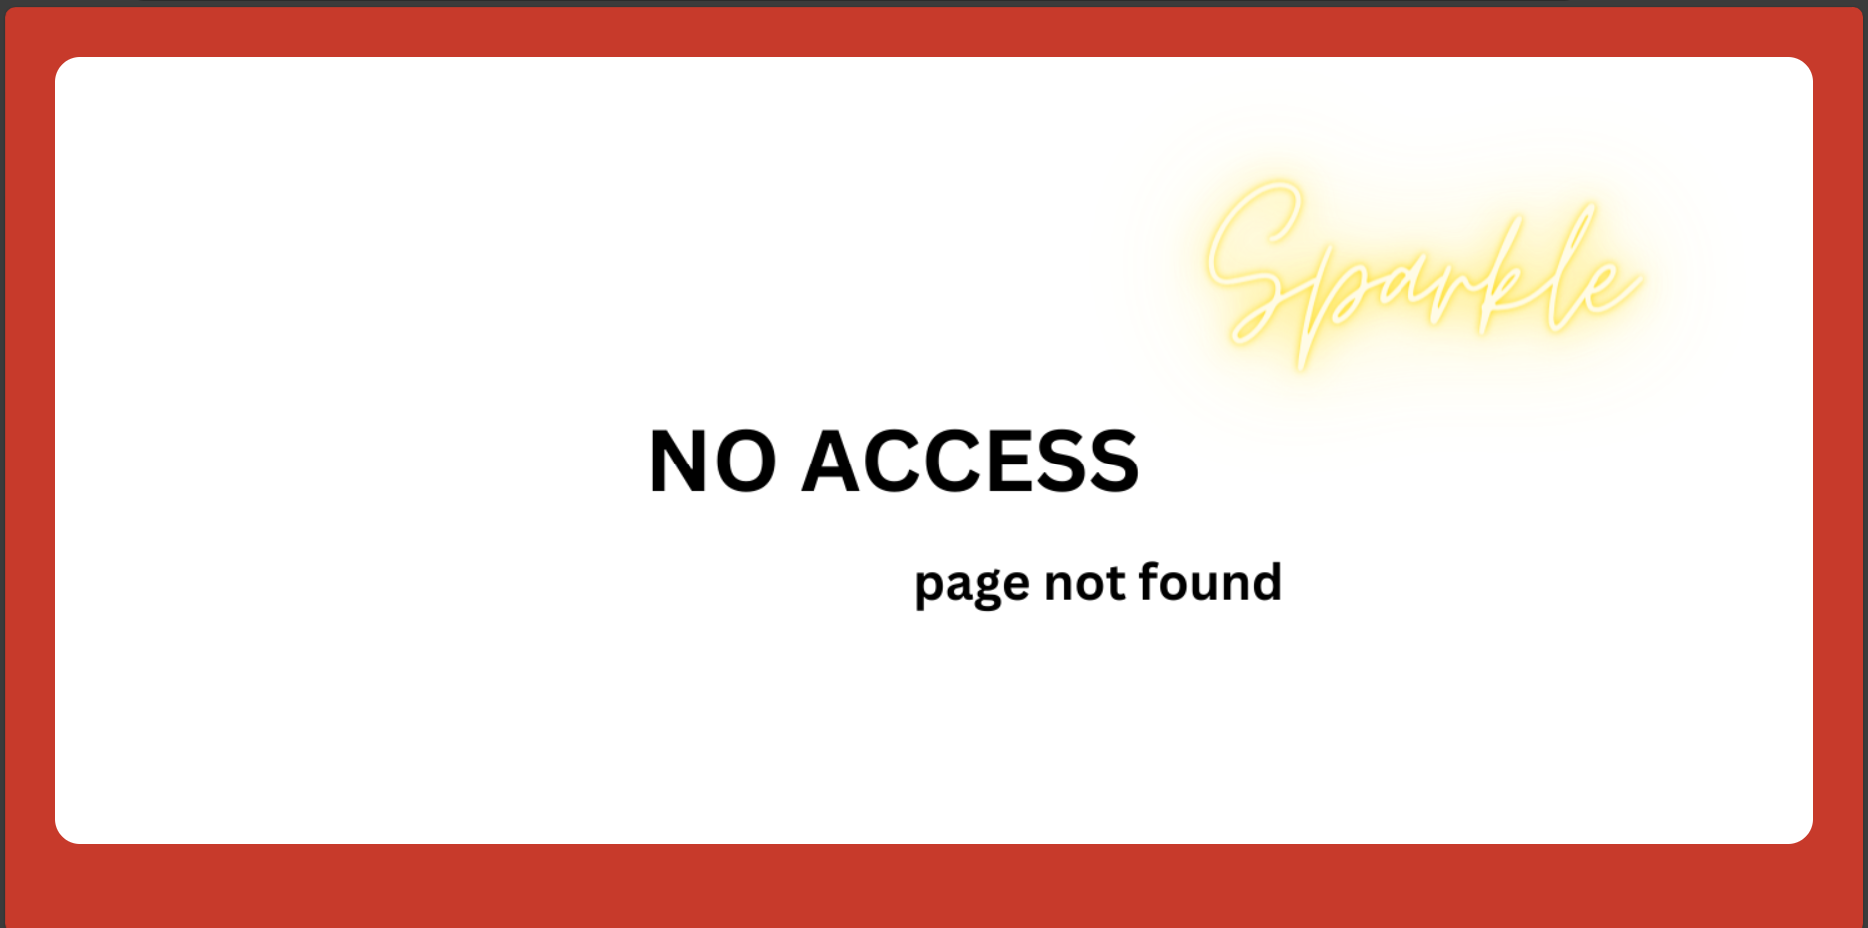
No Response page:

Slide 14

404Error:

Slide 15
Future Enhancements:
Advanced Collaboration Features: Integrate advanced collaboration tools such as real-time editing with cursor tracking, video conferencing within the application, and commenting features to facilitate seamless communication and interaction among users working on shared notes.
AI-Powered Assistance: Implement AI algorithms for features like automatic summarization, sentiment analysis, and content recommendation to assist users in managing and understanding their notes more effectively.
Enhanced Security Measures: Continuously update and reinforce security measures to protect user data, including encryption for data transmission and storage, multi-factor authentication, and regular security audits to identify and address potential vulnerabilities.
Offline Mode and Syncing: Implement offline access to notes with automatic syncing when the user reconnects to the internet, enabling users to work seamlessly even when they're offline or experiencing connectivity issues.
Social Features: Introduce social features such as user profiles, activity feeds, and public note sharing to foster a sense of community and facilitate knowledge exchange among users within the application.

Slide 16
Conclusion
In conclusion, the development of a note-sharing web application presents a significant opportunity to enhance collaboration, productivity, and knowledge sharing among users. By providing a user-friendly platform for creating, organizing, and sharing notes, such an application can streamline workflows, facilitate seamless communication, and promote collective learning.
Through the implementation of features such as real-time collaboration, version control, and access permissions, the note-sharing web application can cater to the diverse needs of individuals, teams, and organizations across various industries and domains. Additionally, integrating robust security measures ensures the confidentiality and integrity of shared information, fostering trust and reliability among users.
Source :

Slide 17
Thank You!
Notes:
Thank You !!

